Slide 1

Security Challenges & Solutions in Cloud Computing
Prof. Dr. Pardeep Kumar

Slide 2

Introduction to Cloud Computing
It’s the delivery of computing services over the internet
On-demand access, scalability, pay-as-you-go model
IaaS, PaaS, SaaS
Cost-efficiency, flexibility, accessibility

Slide 3

If cloud computing is so great, why isn’t everyone doing it?
The cloud is a big black box, nothing inside is visible to the clients and they don’t have control over what happens inside a cloud.
Even if the cloud provider is honest, it can have malicious system admins who can tamper with client data.
Clouds are still subject to traditional data confidentiality, integrity, availability, and privacy issues, plus some additional attacks.

Slide 4
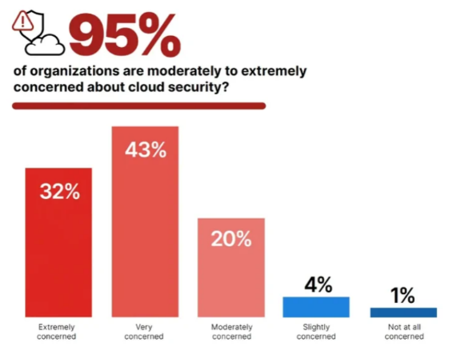
Cloud Security Concerns

Slide 5
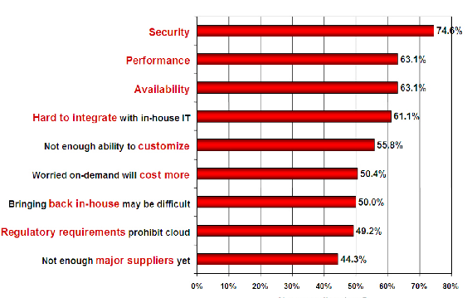
Companies are still afraid to use clouds

Slide 6
Cloud Security Background
Organizations are adopting cloud computing at a rapid pace to benefit from increased efficiency, better scalability, and faster deployments.
However, this has not decreased the concerns about security, data, systems, and services.
Most of successful attacks on cloud services are the result of customer misconfiguration, mismanagement, and mistakes.

Slide 7
Is cloud security better than yours?
Cloud computing makes sense if your own security is weak, having missing features, or is below average.
Ultimately, if
the cloud provider’s security people are “better” than yours,
the web-services interfaces don’t introduce too many new vulnerabilities, and
the cloud provider aims at least as high as you do, at security goals,
then cloud computing has better security.

Slide 8
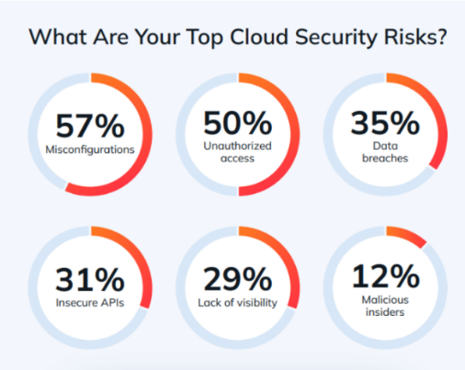
Top Cloud Security Risks

Slide 9
Latest Statistics – 2024-25
Cybercrime costs an organization about $13.0 million on average (Source: Accenture)
The average cost of a data breach rose to $4.88 million in 2024 (Source: IBM)
Ransomware accounts for 24% of all cyberattacks in 2025 (Source: Integrity360)
Data breaches exposed over 16.8 billion records in 2024 (Source: Flashpoint)
73% believe cloud technology has increased complexity (Source: Fujitsu)
IT downtime costs an average of $14,056 per minute in 2024 (Source: BigPanda)
It takes almost two hours to resolve server downtime (Source: Veeam)
An hour of downtime costs $60K to $100K (Source: Accenture)
Misconfiguration is responsible for 68% of issues (Source: Fortinet)
Misconfiguration (68%)
Unauthorized access (58%)
Insecure interfaces (52%)
Hijacking of accounts (50%)

Slide 10
Security Challenges in Cloud Computing
Data breaches
Insecure APIs
Account hijacking
Shared technology vulnerabilities
Data loss
Insider threats
Compliance and legal issues
Lack of Trust
Multi-tenancy issues

Slide 11

Data Breaches
Unauthorized access to sensitive data
Causes: Weak authentication, software vulnerabilities, human error
Impact: Financial loss, reputation damage, legal consequences
Capital One data breach (2019) affected 100 million customers

Slide 12
Insecure APIs
Application Programming Interfaces (APIs) enable cloud service interactions
Authentication, access control, encryption issues
Consequences: Data exposure, unauthorized access, service disruption
Best practices: API security testing, proper authentication, rate limiting

Slide 13
Account Hijacking
Unauthorized access to user accounts
Phishing, keylogging, credential stuffing (automated cyberattack that inserts stolen usernames and passwords to achieve an account takeover (ATO)
Data theft, financial fraud, service abuse risks
Prevention: Strong authentication, user education, monitoring

Slide 14
Shared Technology Vulnerabilities
Multi-tenancy nature of cloud computing
Risks: Exploitation of shared resources, side-channel attacks
Examples: Meltdown and Spectre vulnerabilities (Meltdown breaks isolation between apps and the OS, while Spectre breaks isolation between apps)
Mitigation: Regular patching, isolation techniques, monitoring

Slide 15
Data Loss
Due to Accidental Deletion, Physical Disasters, Malicious Attacks
Business Disruption, Legal Issues, Financial Impact
Prevention: Regular Backups, Data Redundancy, Disaster Recovery Planning
Myspace Data Loss (2019) affected 12 Years of User Content

Slide 16

Insider Threats
Security risks from within the organization
Malicious insiders, negligent employees, compromised accounts
Data theft, sabotage, unauthorized access risks
Mitigation: Access controls, employee training, monitoring

Slide 17

Compliance and Legal Issues
Regulatory requirements
GDPR (General Data Protection Regulation)
HIPAA (Health Insurance Portability and Accountability Act)
PCI DSS (Payment Card Industry Data Security Standard)
Challenges: Data sovereignty, privacy laws, audit requirements
Risks: Legal penalties, reputation damage, loss of business
Solutions: Compliance frameworks, regular audits, data governance

Slide 18
Lack of Trust in the Cloud
Trusting a third party requires taking risks
Defining trust and risk
Opposite sides of the same coin (J. Camp)
People only trust when it pays (Economist’s view)
Need for trust arises only in risky situations
Hard to balance trust and risk
Notes:
Chiles and McMakin (1996) define trust as increasing one’s vulnerability to the risk of opportunistic behavior of another whose behavior is not under one’s control in a situation in which the costs of violating the trust are greater than the benefits of upholding the trust.
Trust here means mostly lack of accountability and verifiability

Slide 19
Multi-tenancy Issues
Tenants share a pool of resources and have conflicting goals
Can tenants get along together and ‘play nicely’ ?
If they can’t, can we isolate them?
How to provide separation between tenants?
Cloud Computing brings new threats
Multiple independent users share the same physical infrastructure
Thus, an attacker can legitimately be in the same physical machine as the target
Notes:
Who are my neighbors? What is their objective? They present another facet of risk and trust requirements

Slide 20
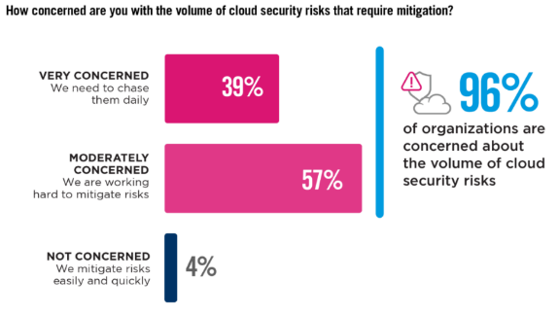
Volume of Cloud Security

Slide 21
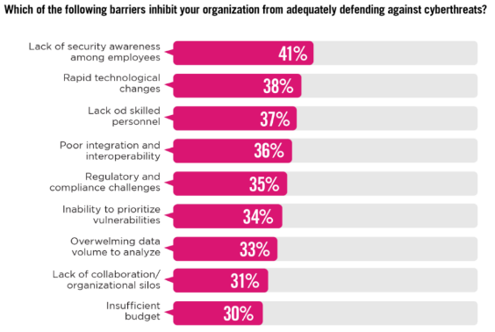
Cyberthreats Barriers

Slide 22
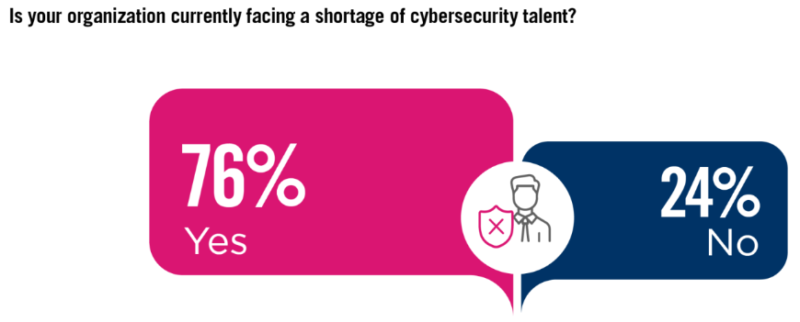
Cybersecurity Experts

Slide 23
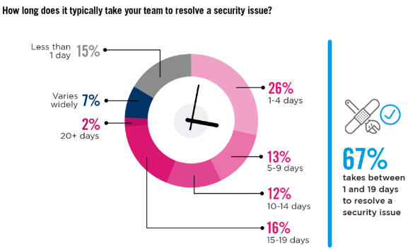
Time to Security Issues

Slide 24
Cloud Security Solutions
Encryption
Access Management
Network Security
Data Loss Prevention
Security Information And Event Management (SIEM)
Cloud Security Posture Management (CSPM)

Slide 25
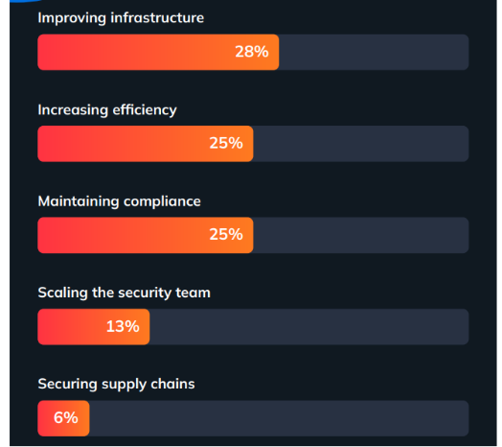
Top Cloud Security Objectives in 2024-25

Slide 26
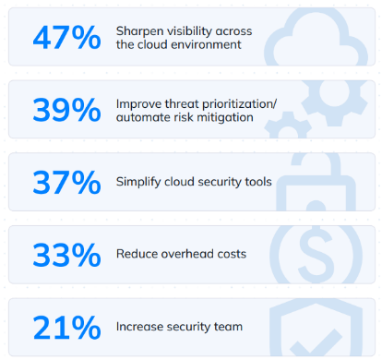
How to Improve Cloud Security Posture?

Slide 27
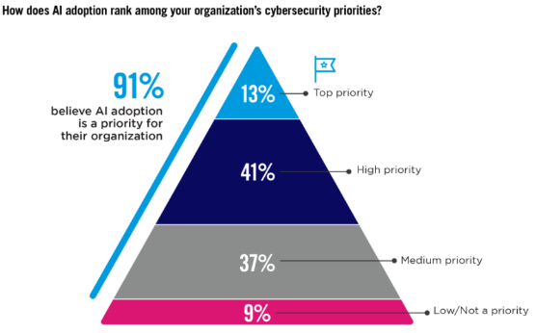
AI in Cloud Security

Slide 28
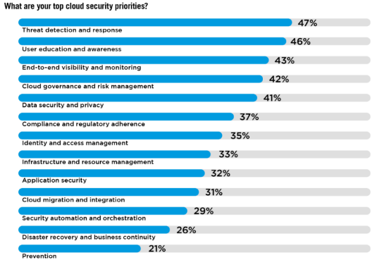
Security Priorities

Slide 29
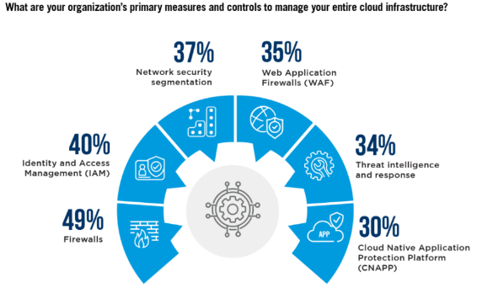
Managing Cloud Infrastructure

Slide 30
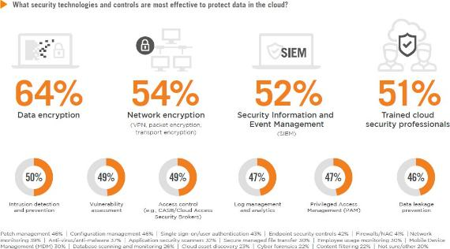
Effective Technologies

Slide 31
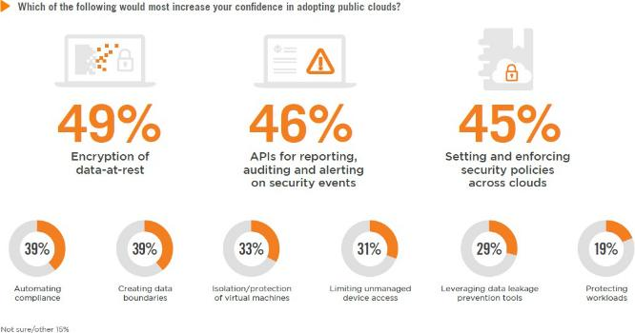
Cloud Confidence Booster

Slide 32

Encryption
Data-at-rest encryption: Protecting stored data
Data-in-transit encryption: Securing data during transfer
Key management: Secure storage and rotation of encryption keys
Homomorphic encryption: Processing encrypted data without decryption

Slide 33
Access Management
Identity and Access Management (IAM)
Multi-Factor Authentication (MFA)
Single Sign-On (SSO)
Principle of Least Privilege
Role-Based Access Control (RBAC)

Slide 34

Network Security
Virtual Private Networks (VPNs)
Firewalls and Web Application Firewalls (WAF)
Intrusion Detection and Prevention Systems (IDS/IPS)
Microsegmentation
DDoS protection

Slide 35
Data Loss Prevention (DLP)
Definition: Policies and Tools to Prevent Data Leakage
Features: Content Inspection, Contextual Analysis, Policy Enforcement
Implementation: Network DLP, Endpoint DLP, Cloud DLP
Benefits: Compliance, Data Protection, Risk Mitigation

Slide 36

Security Information and Event Management (SIEM)
Purpose: Centralized logging and analysis of security events
Components: Log collection, correlation, alerting, dashboards
Benefits: Real-time threat detection, incident response, compliance
Challenges: Data volume, false positives, skilled personnel requirement

Slide 37
Cloud Security Posture Management (CSPM)
Continuous monitoring and improvement of cloud security
Features: Configuration assessment, compliance monitoring, risk visualization
Benefits: Misconfigurations detection, compliance automation, risk reduction
Implementation: Integration with cloud providers' APIs and security tools

Slide 38
Best Practices for Cloud Security
Implement a robust security policy
Conduct regular security assessments and penetration testing
Train employees on security awareness
Keep software and systems up-to-date
Implement strong authentication and access controls
Encrypt sensitive data
Monitor and log all activities
Have an incident response plan

Slide 39
Emerging Trends in Cloud Security
Zero Trust Security model
AI and Machine Learning for threat detection
Serverless security
Quantum-resistant cryptography
Blockchain for enhanced security and transparency
DevSecOps integration

Slide 40
Conclusion
Cloud security is a shared responsibility between providers and users
Addressing challenges requires a multi-layered approach
Continuous monitoring and improvement are essential
Stay informed about emerging threats and solutions
Balancing security with usability and performance is key
The future of cloud security lies in automation and advanced technologies

Slide 41

Questions and Discussion
What security challenges have you encountered in cloud computing?
How do you balance security requirements with cloud benefits?
What additional security measures does your organization implement?
Are there any specific areas of cloud security you'd like to explore further?

